Slide 1

The cBioPortal for Cancer Genomics
Ino de Bruijn, JJ Gao
Knowledge Systems Group
Kravis Center for Molecular Oncology

Slide 2


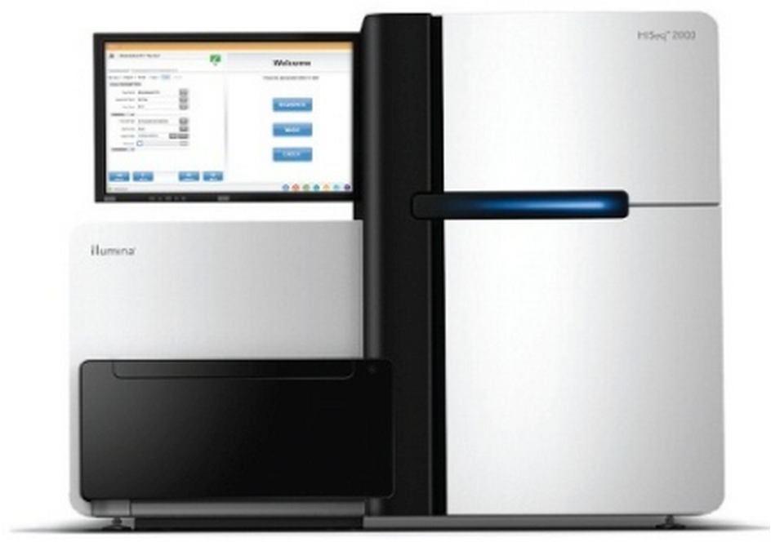
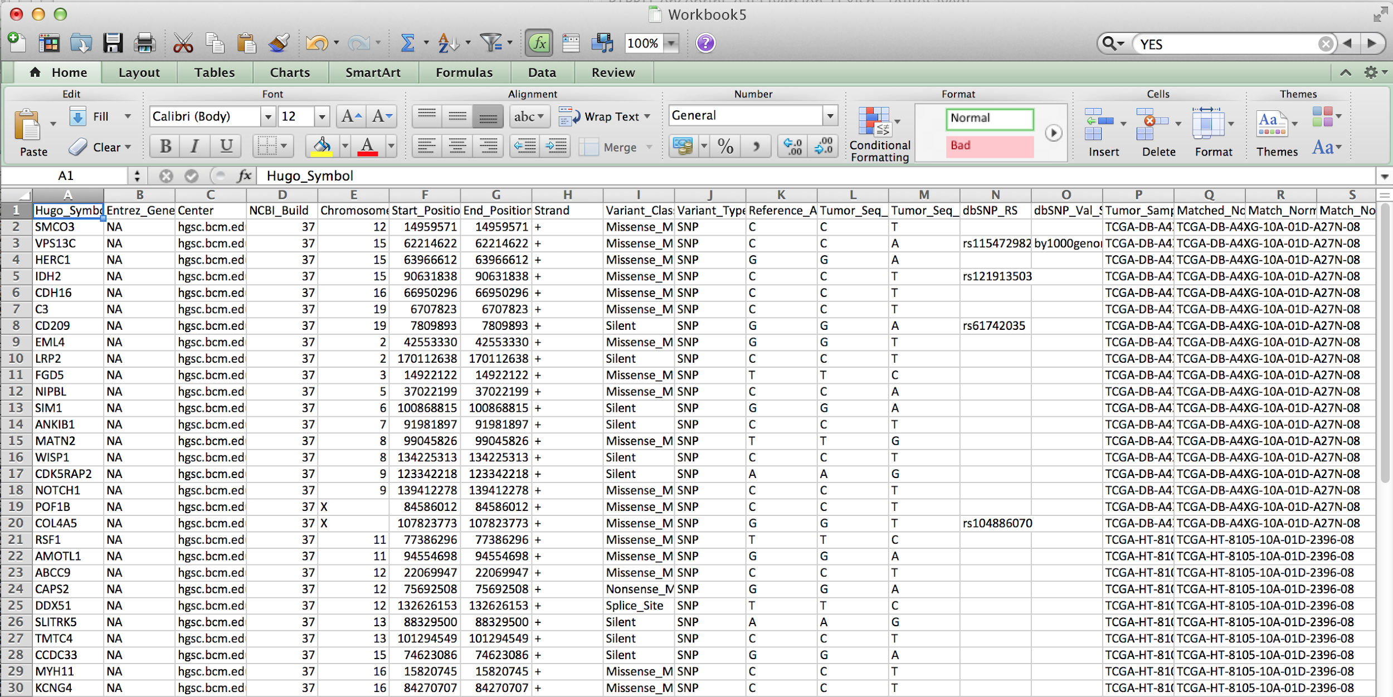
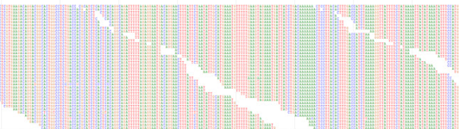
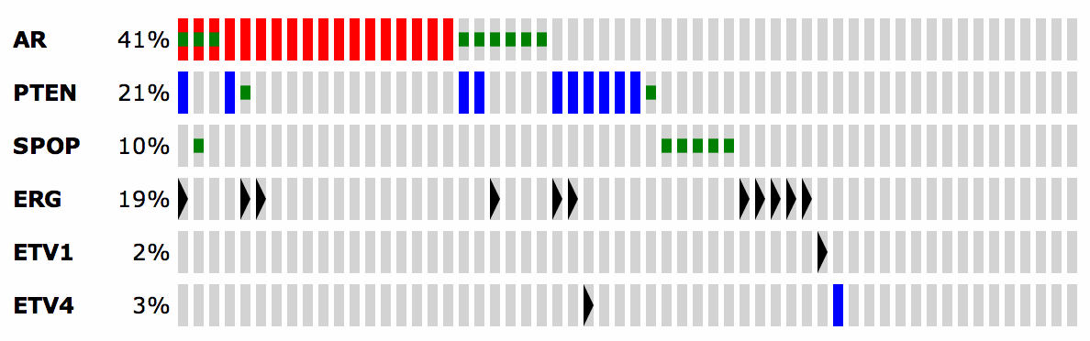
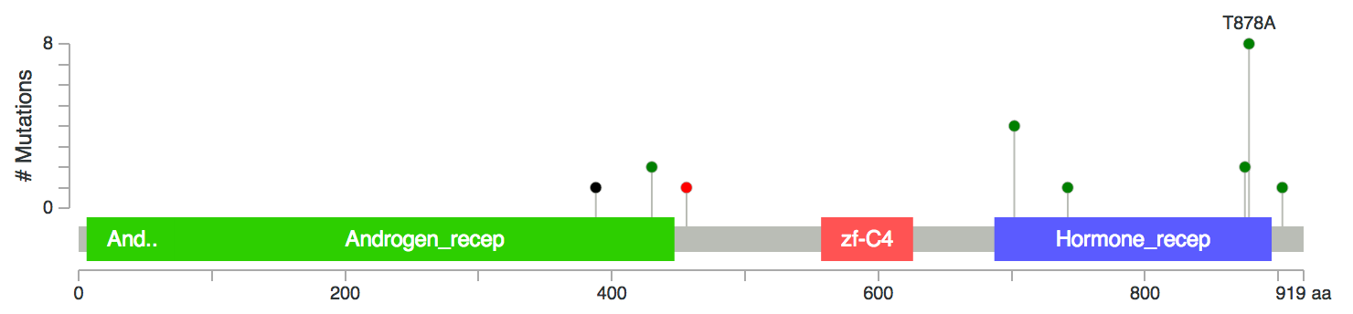
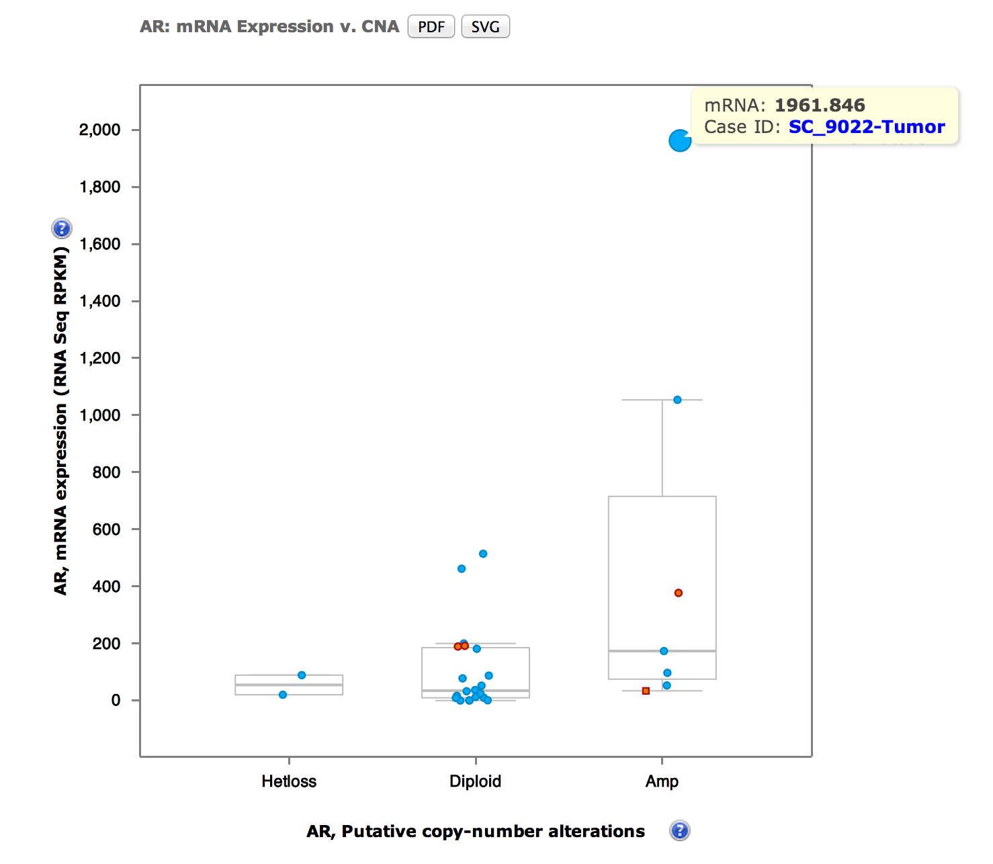
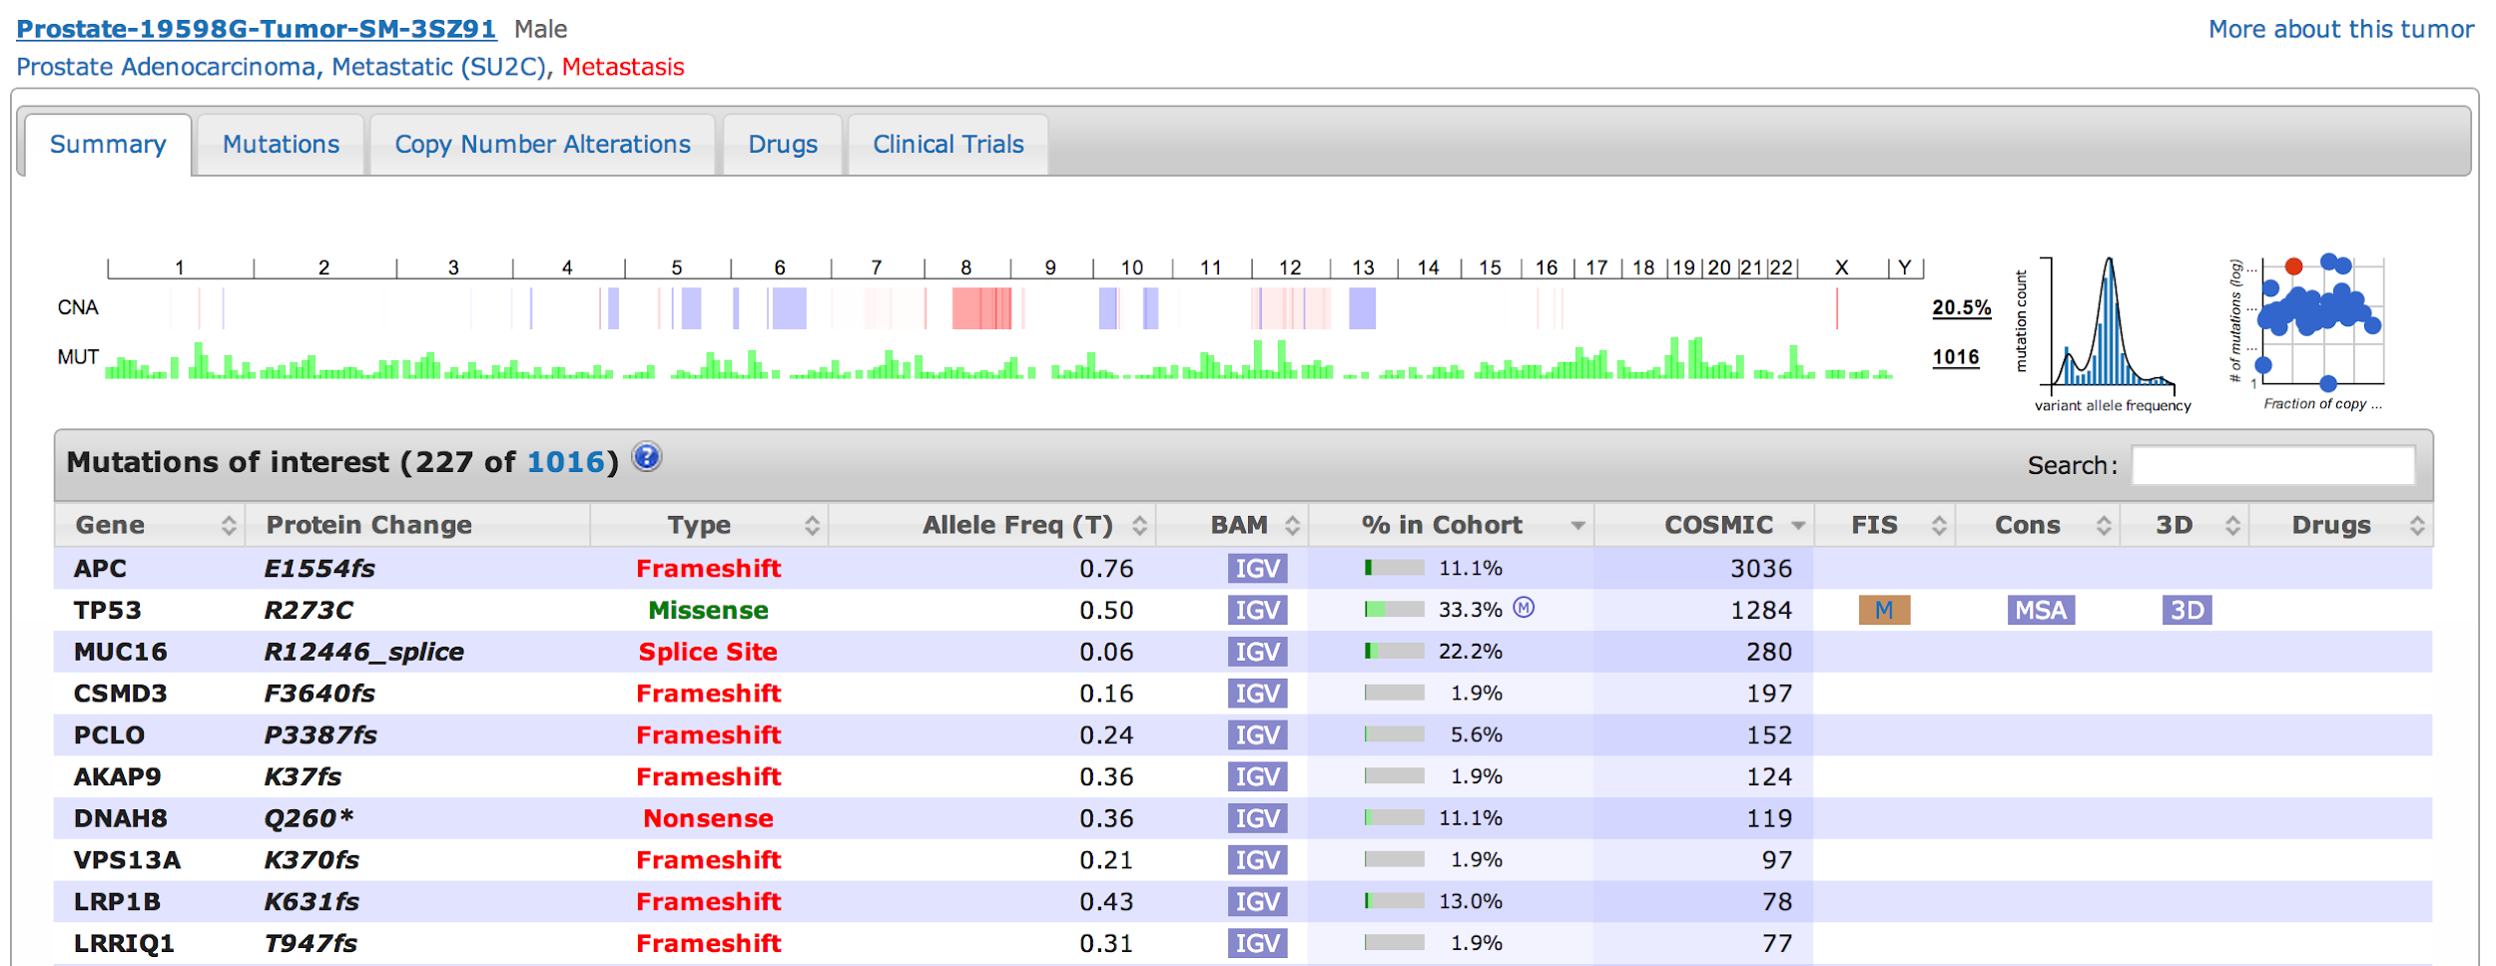

cBioPortal for Cancer Genomics: Data to knowledge / the last mile
Tumor DNA
DNA sequencer, microarrays …
Tumor and normal sequences
Data
Intuitive interface, quick response time, reduction of complexity

Slide 3


cBioPortal is open source software
https://github.com/cBioPortal/cbioportal
Licensed under the AGPL license
Free to download and use
Modifications welcome
Software is now developed and maintained by multiple institutions
MSK, DFCI, Princess Margaret, CHOP, Cornell, The Hyve
Thousands of users at cbioportal.org
cBioPortal is installed at dozens of institutions and companies
Commercial support is available from The Hyve

Slide 4
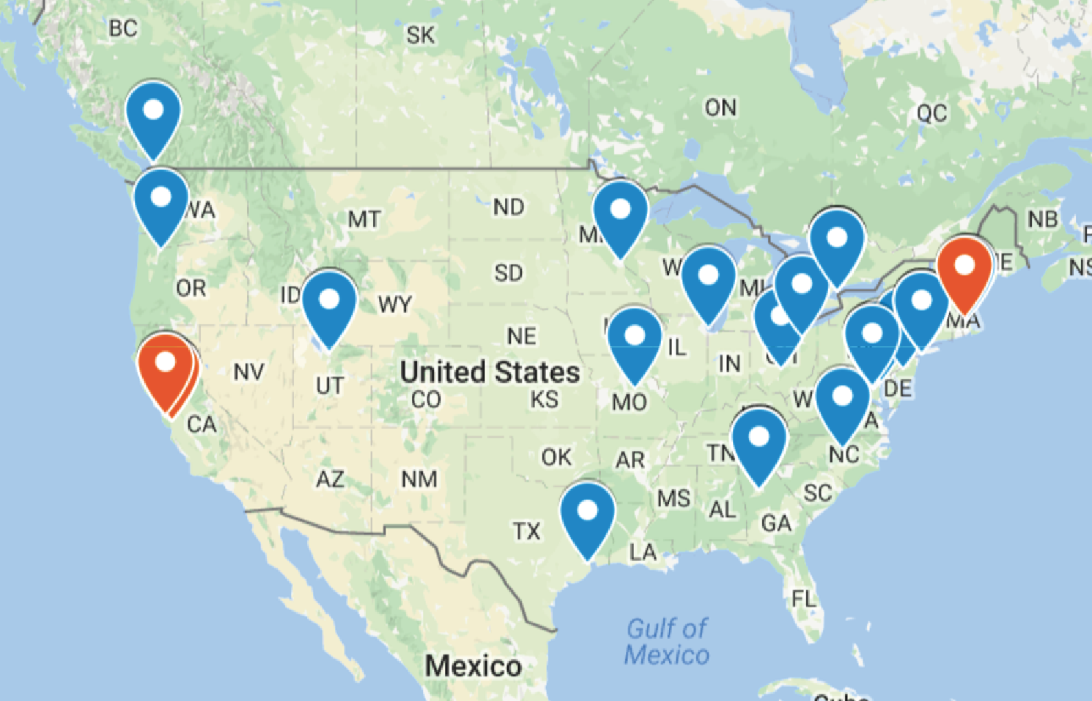
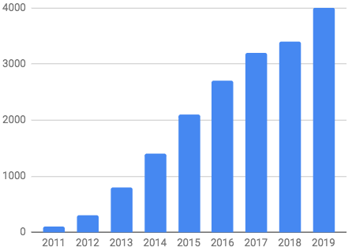
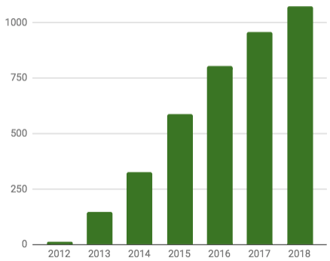
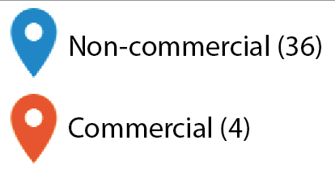
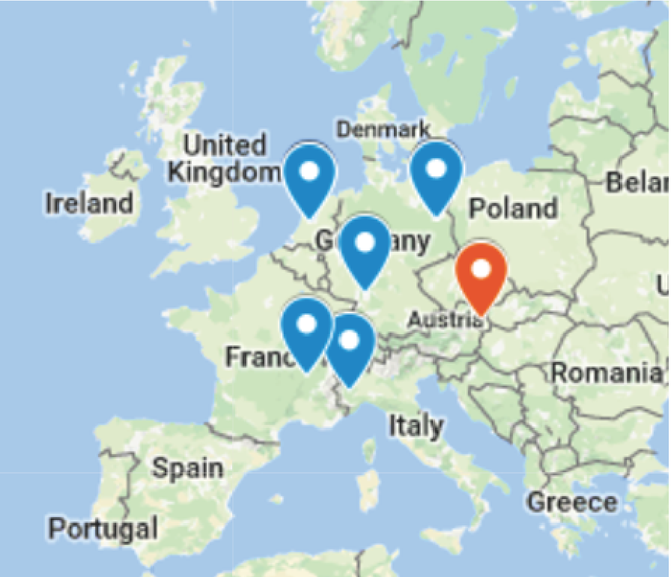

cBioPortal use
~4,000 daily visits
>4,000 citations
+ AACR Project GENIE instance
+ private SU2C, BCRF PDX, TCGA, POETIC, …
Local instances →
Cerami, et al. Cancer Discovery 2012
Gao, et al. Science Singling 2013

Slide 5
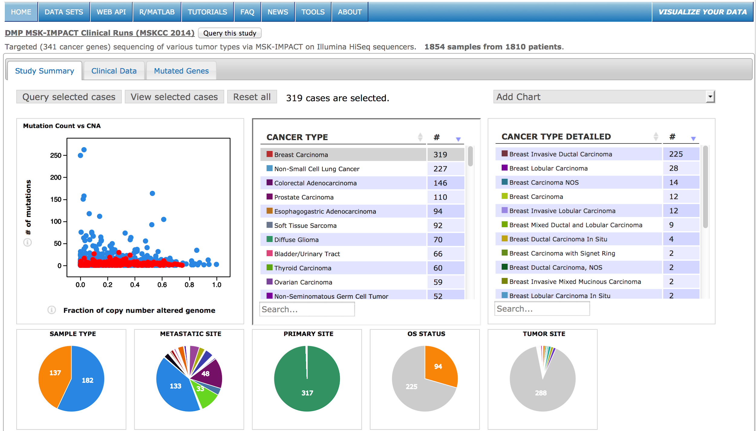
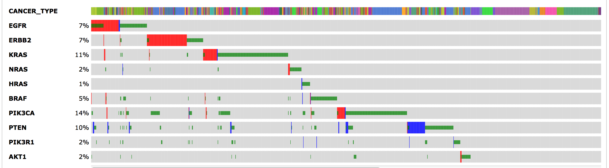
cBioPortal at MSK
cBioPortal
CMO Research
Clinical MSK-IMPACT
Genomic data
Foundation Medicine
TCGA, ICGC
Other public data

Slide 6
cBioPortal at MSK
12,000
cBioPortal
CMO Research
40,000
Clinical MSK-IMPACT
2000
Genomic data
Foundation Medicine
10,000
TCGA, ICGC
13,000
Other public data

Slide 7


cBioPortal at MSK
cBioPortal
CMO Research
Clinical MSK-IMPACT
Genomic data
Foundation Medicine
TCGA, ICGC
Other public data
MSK clinical data
CRDB

Slide 8



cBioPortal at MSK
cBioPortal
CMO Research
Clinical MSK-IMPACT
Variant effect
Therapy Options
Genomic data
Foundation Medicine
Recurrence
TCGA, ICGC
Other public data
MSK clinical data
CRDB

Slide 9
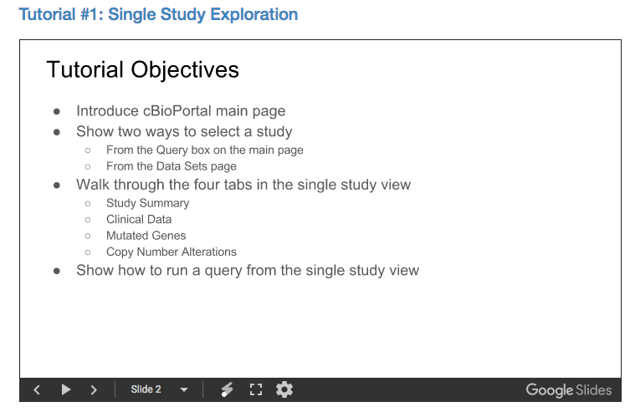
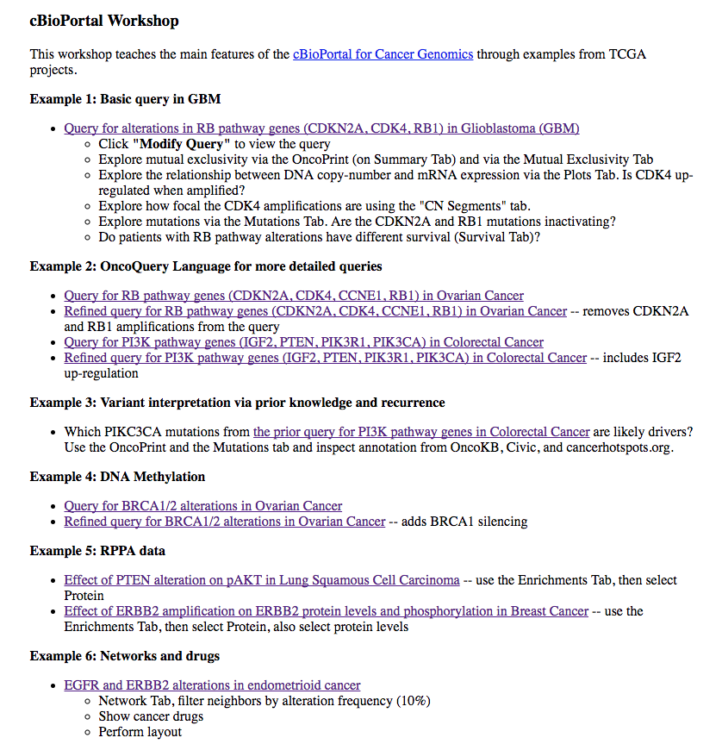
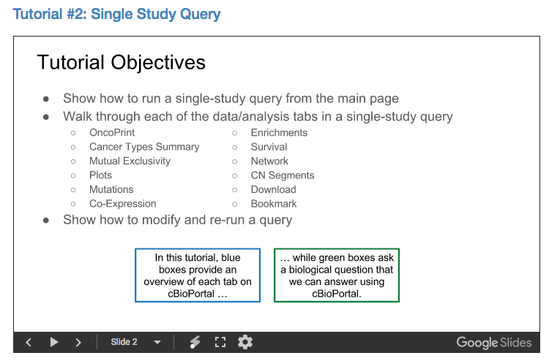
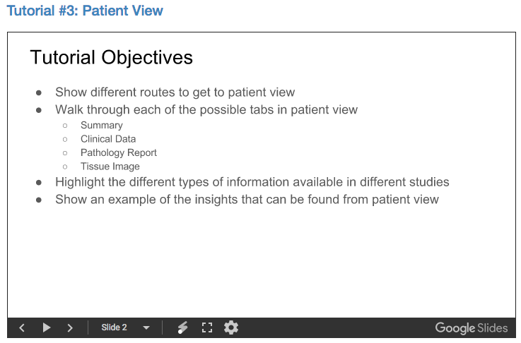


Tutorials / Help / Hel?
http://www.cbioportal.org/tutorials
https://bit.ly/mskportalworkshop-20191028

Slide 10

Live Demo
https://www.cbioportal.org/
https://cbioportal.mskcc.org/
https://bit.ly/mskportalworkshop-20191028
Also available: http://cbioportal.org/genie/
>70,000 samples from 8 institutions

